Slide 1
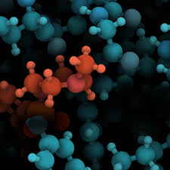
Molecular Dynamics(MD) Simulation
1 of 15
Physics-77
Group 9 Members:
Wenhan Hua Zipeng Wu
Shiyu Li Xinheng Li

Slide 2
Content
2 of 15
Introduction to ensemble theory Shiyu
Program design Xinheng
Simulation results Zipeng
Maxwell’s Demon and Outlook Wenhan

Slide 3
A theoretical approach before computer is invented
3 of 15
Object: many-body system
Why can’t we just solve the equa. of motions following the Newton’s Laws?
Because there are too many of them! (macroscopic number, 10^23)
Solution: Ensemble theory

Slide 4
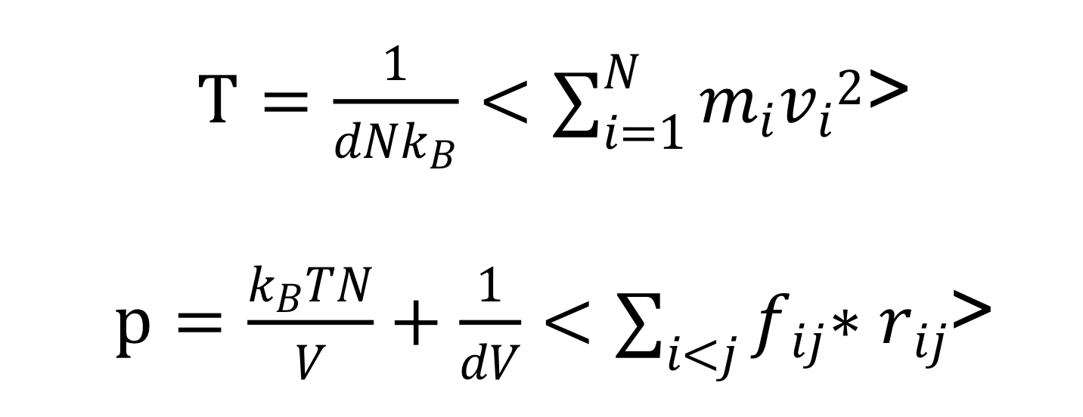
Ensemble theory
4 of 15
Ergodic Assumption: all accessible microstates are equiprobable over a long period of time
Types of ensembles: NVT, NVE, μVT
Relations between microscopic quantities and macroscopic quantities:
N is the number of particles
V is the volume of the system
d is the degrees of freedom, in 3D, d=3*N-3
kB is the Boltzmann constant

Slide 5
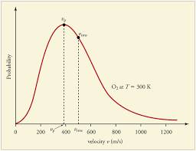
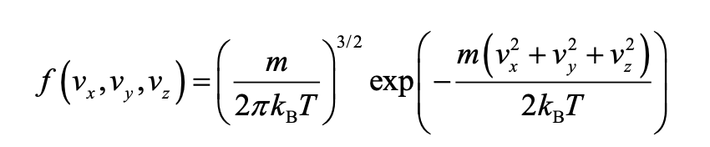
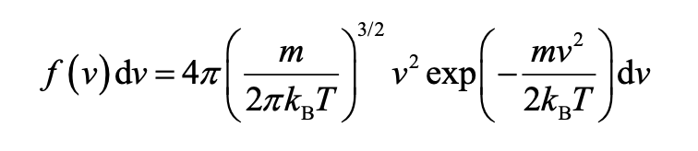
Maxwell-Boltzmann distribution
5 of 15

Slide 6
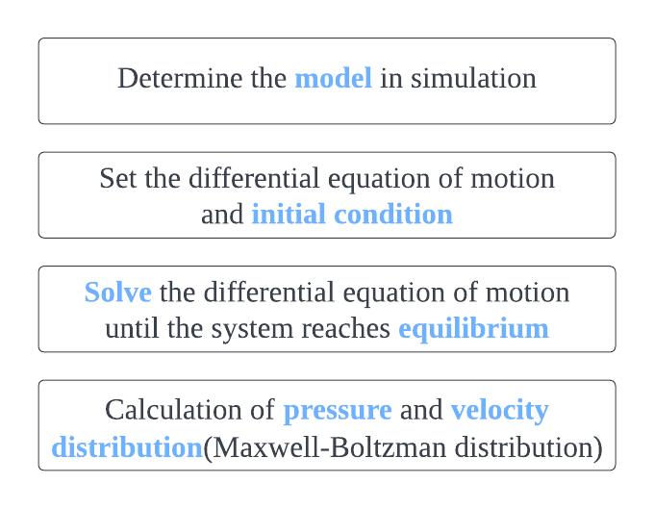
Molecular Dynamics(MD) Simulation
6 of 15
A simulation method for analysing the dynamic evolution of particles

Slide 7
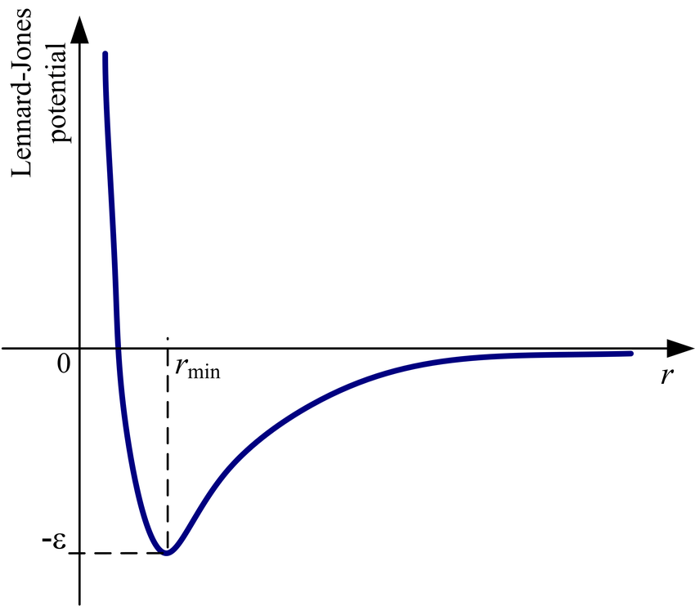
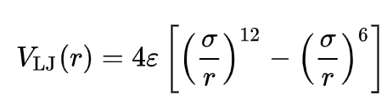
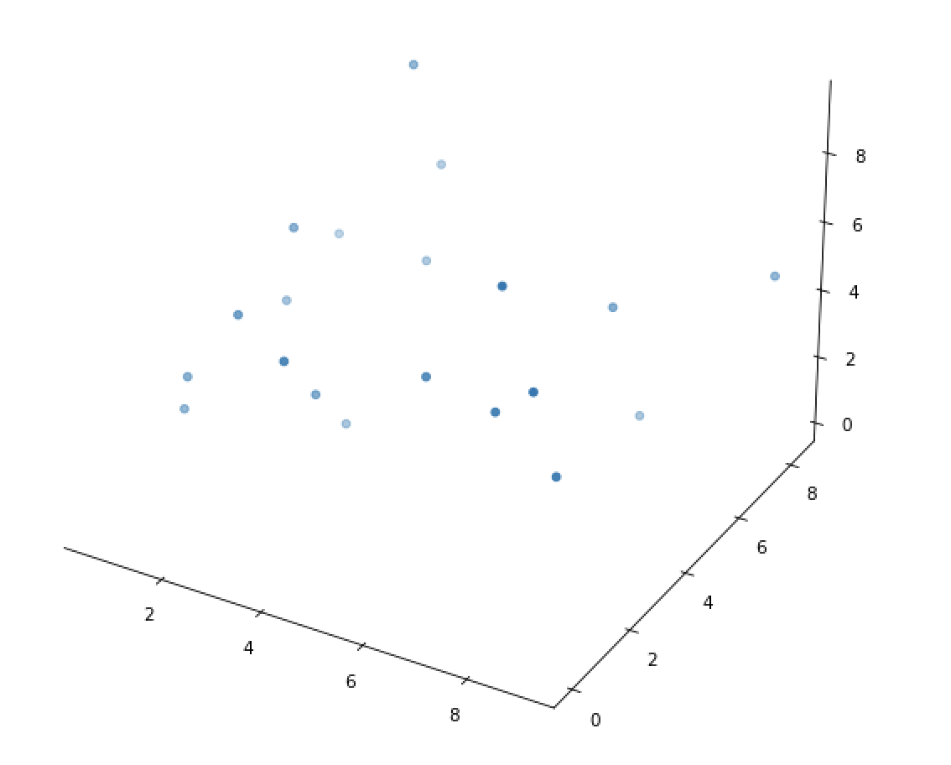
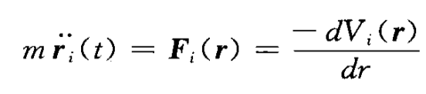
Model
7 of 15
Lennard - Jones Potential
Canonical Ensembles: NVT
Microcanonical Ensembles: NVE
Assumption:
Periodic Boundary Condition
X ( nL + a ) = X ( a )
Newton’s Law of motion

Slide 8
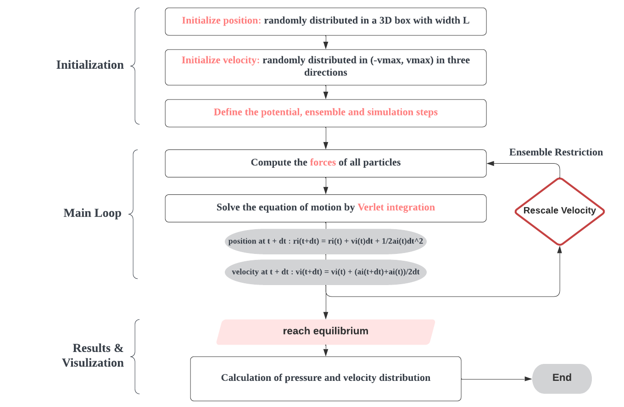
Structure
8 of 15

Slide 9
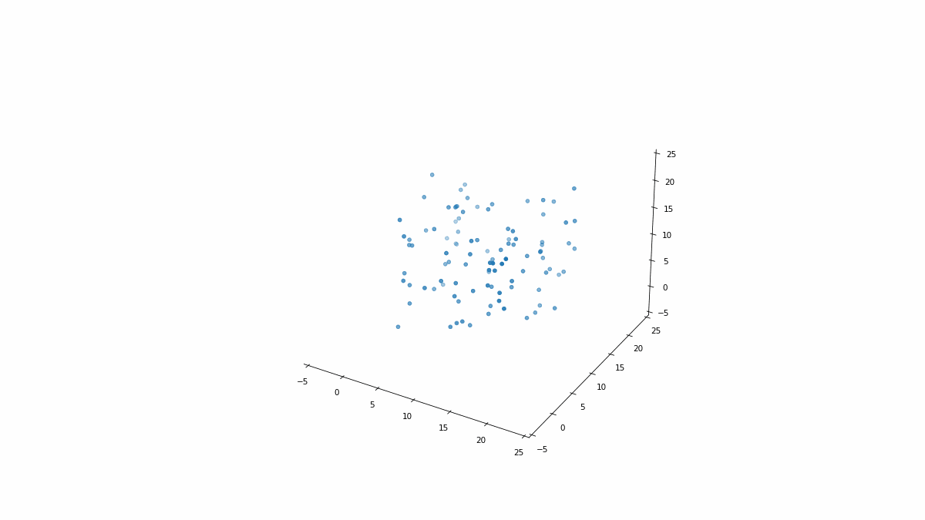
Animation
9 of 15
100 particles 500 steps(0.5s, extent to 10s in GIF) T=300K
Notes:
Periodic boundary conditions.
Argon
V=20^3(m^3)

Slide 10
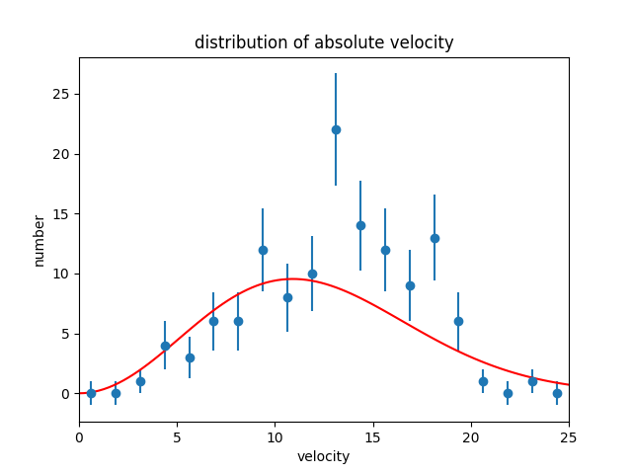
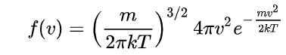
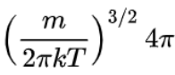
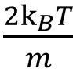
Distribution of the velocity
10 of 15
M-B Distribution:
 | theory | simulation
 | 0.00162 | 0.00133
 | 124 | 119
Total steps: 20000 N=128
Notes:
1 the amount of the particle in our simulation is not large enough. This contributes to the huge error bar shown here.
The number of the number at a certain velocity fellows persson distribution. The less the number of particles, the larger the error will be.
Scipy.optimize package in python
Argon

Slide 11
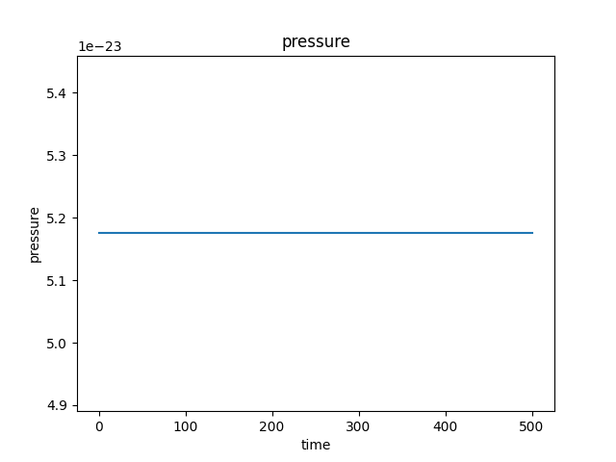
Pressure
11 of 15
Almost a constant.

Slide 12
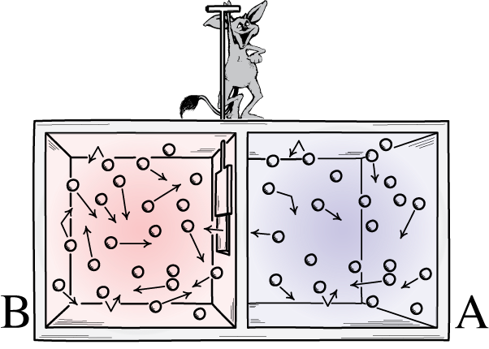
Put a Maxwell’s Demon!
12 of 15
One of the famous paradoxes in statistical physics
Creator: physicist James Clerk Maxwell (1867)
to contradict the second law of thermodynamics
What the demon do:
quickly opens and closes the door
only fast-moving molecules to pass from A to B
only slow-moving molecules to pass from B to A
A
B

Slide 13
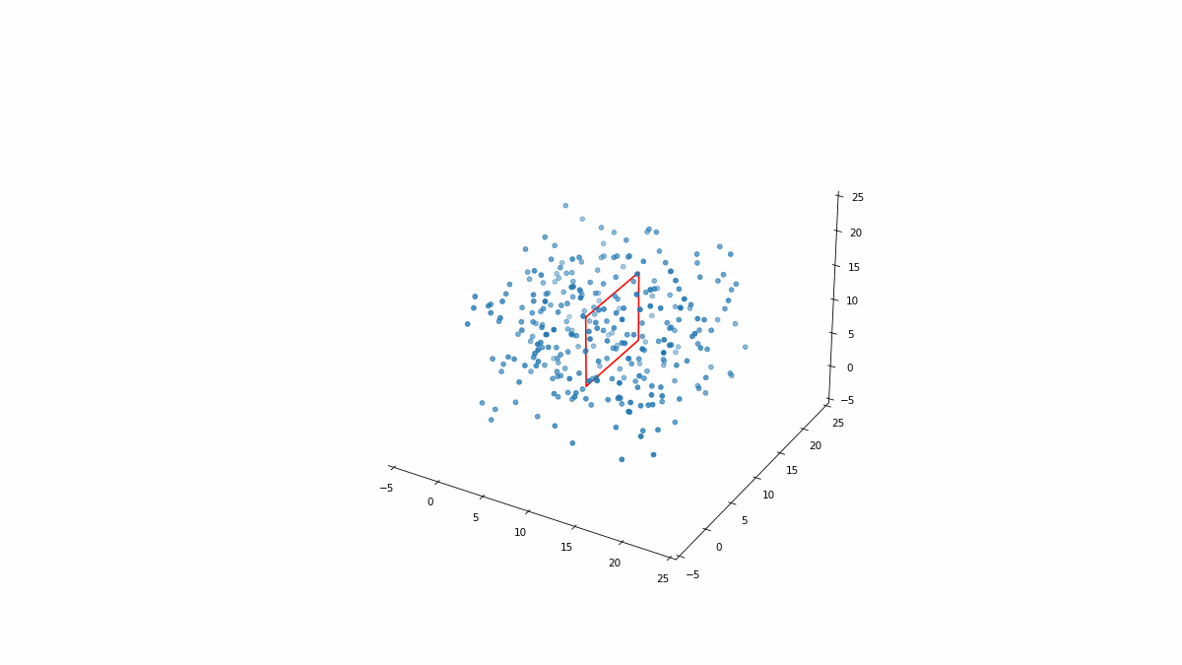
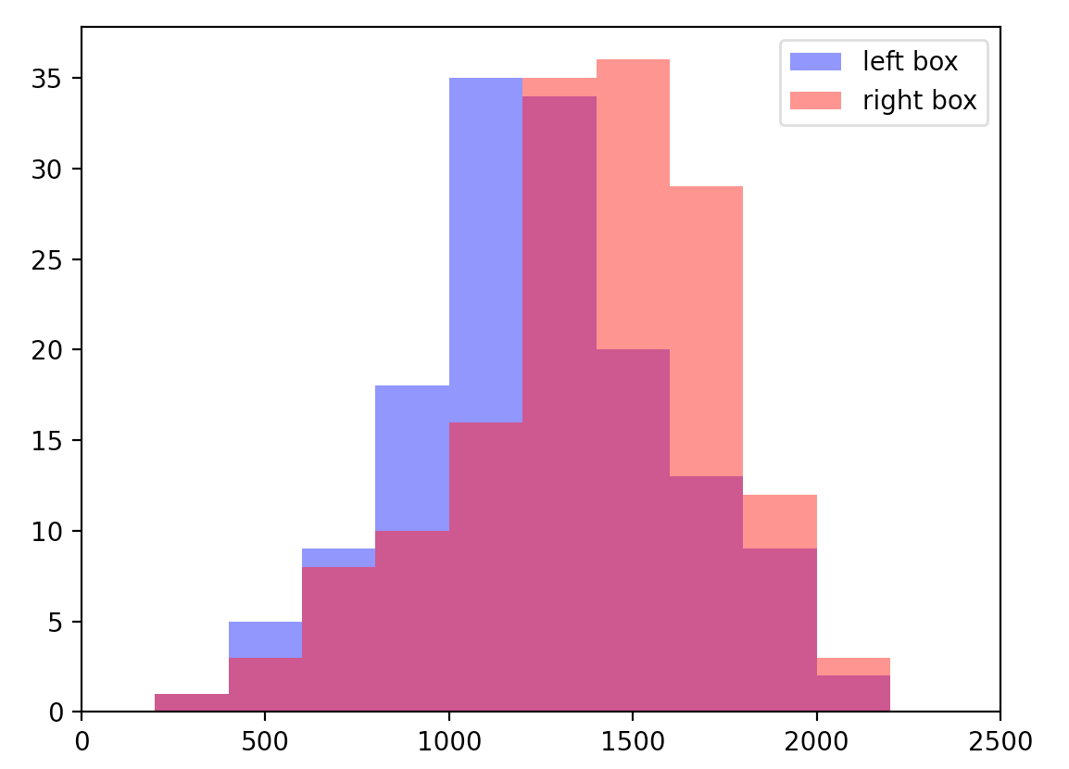
Result of Maxwell’s Demon MD Simulation
(300 particles, 6000 steps, NVT, T_initial = 300K)
13 of 15
Animation:
Distribution of velocity in two boxes:
Kinetic energy/Temperature of two boxes( initially same, and after 6000 steps)
Left: 0.801e-18 Joule T_left = 258.0 K
Right: 1.057e-18 Joule T_right = 340.2K

Slide 14
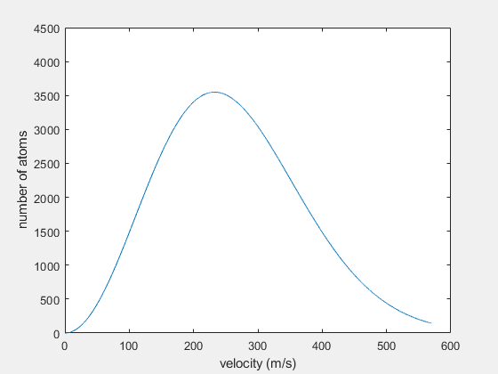
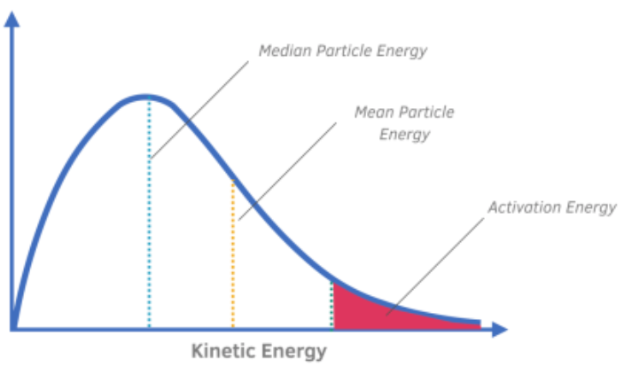
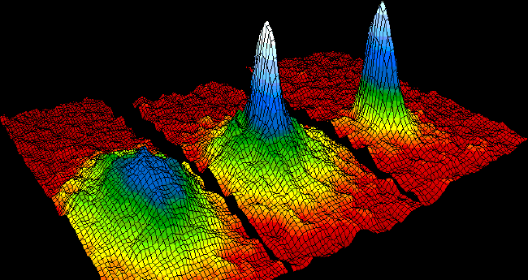
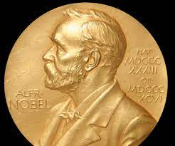
Maxwell’s Demon & Evaporative Cooling
14 of 15
After infinite time,
Maxwell’s Demon promises an infinite small/large temperature!
Number of Particles in Left Box
(Colder One)
Bose-Einstein Condensate (2001 Nobel Prize)
Eric A. Cornell
Wolfgang Ketterle
Carl E. Wieman
Bounce back to
Left Box
Pass to
Right Box

Slide 15
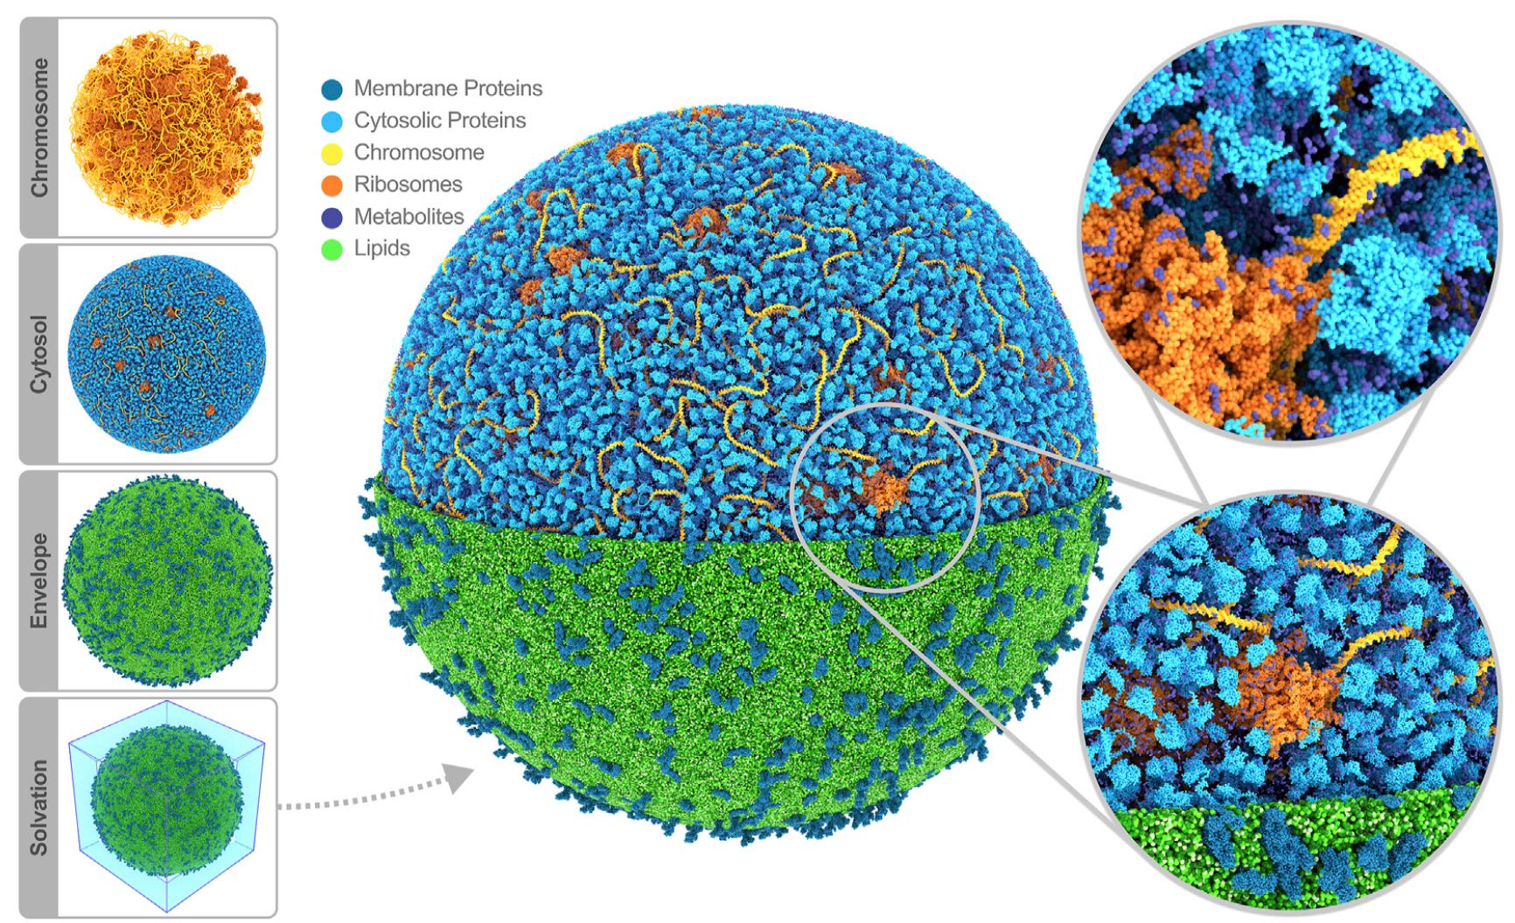
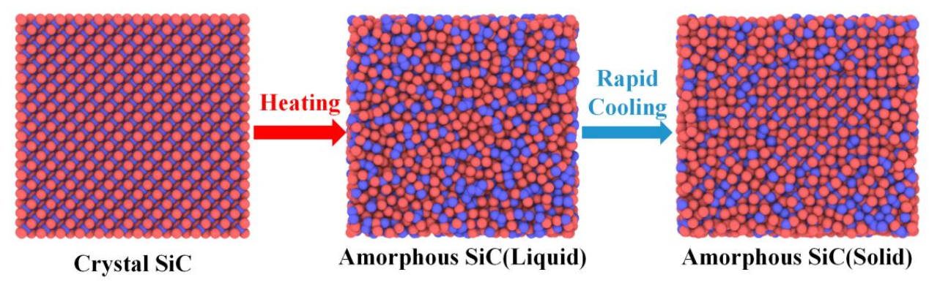
Outlook of MD simulations
15 of 15
Widely used in research! Biomolecule, chemistry, materials, condensed matter …
Limitations:
Limited computational power (storage/time)
Requirements for linking microscopic parameters with macroscopic parameters
MD simulation of SiC materials
(Jan. 2023, Energies)
MD simulation of entire cell(Jan. 2023, Front. Chem)

Slide 16
Q & A

Slide 17
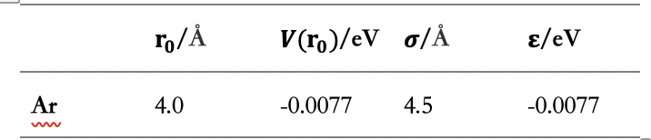
Question: Simulation Parameters
Length L =20
Time step = 1e-3
Parameters in L-J potential

Slide 18
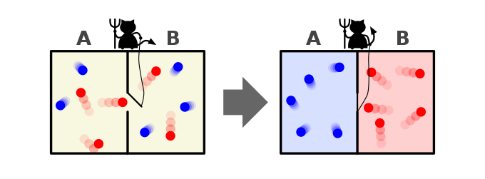
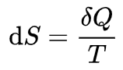
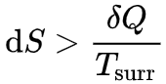
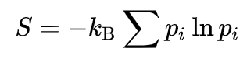
Question: Maxwell Demon Paradox and Entropy
Second Law of Thermodynamics
Basic Idea:
Definition 1: heat always moves from hotter objects to colder objects, unless energy in some form is supplied to reverse the direction of heat flow
Definition 2: Not all heat energy can be converted into work in a cyclic process.
Definition 3: in an isolated system, entropy never decreases
Closed, idealized, reversible process
Closed, idealized, irreversible process
thermodynamic entropy and information entropy
Maxwell Demon: Discard (entropy increase) & Store information

Slide 19
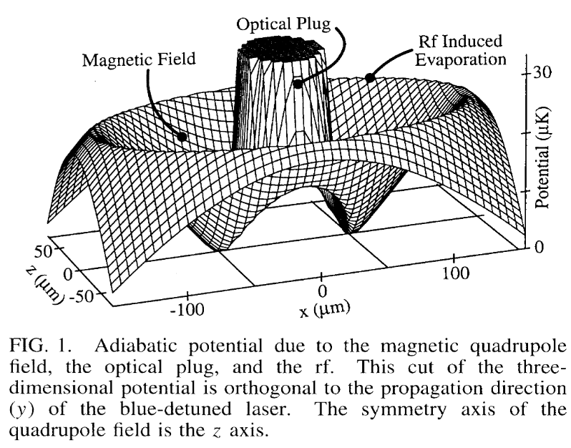
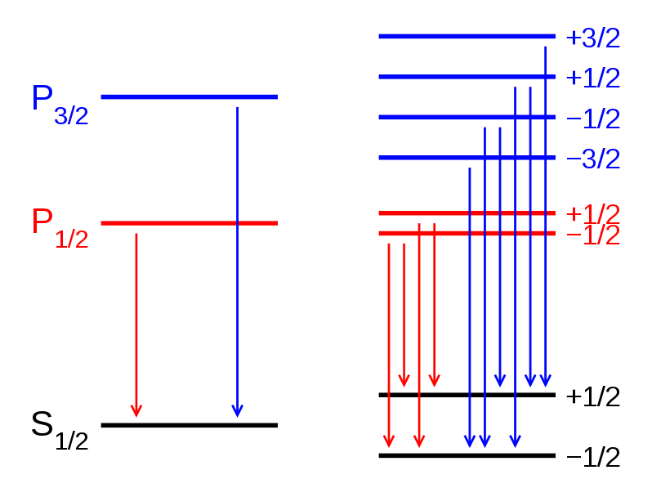
Question: Evaporative Cooling and BEC condensate
M.H. Anderson, J.R. Ensher, M.R. Matthews, C.E. Wieman, E.A. Cornell, Observation of Bose-Einstein Condensation in a Dilute Atomic Vapor, Science. 269 (1995) 198–201. https://doi.org/10.1126/science.269.5221.198.
K.B. Davis, M.-O. Mewes, M.R. Andrews, N.J. van Druten, D.S. Durfee, D.M. Kurn, W. Ketterle, Bose-Einstein Condensation in a Gas of Sodium Atoms, Phys Rev Lett. 75 (1995) 3969–3973. https://doi.org/10.1103/physrevlett.75.3969.
Drive the ions with higher velocity by ‘rf cut’
Driven
By Polarized Light

Slide 20
Verlet Integration
a numerical method to integrate Newton’s equation of motion
v(t) = [x(t+dt) + x(t-dt)]/2dt
x(t+dt) = x(t) + v(t)dt + 1/2a(t)dt^2
x(t-dt) = x(t) - v(t)dt + 1/2a(t)dt^2
x(t+dt) = x(t) + v(t) + 1/2a(t)dt^2
v(t+dt) = v(t) + [a(t)+a(t+dt)]dt/2

